Slide 1
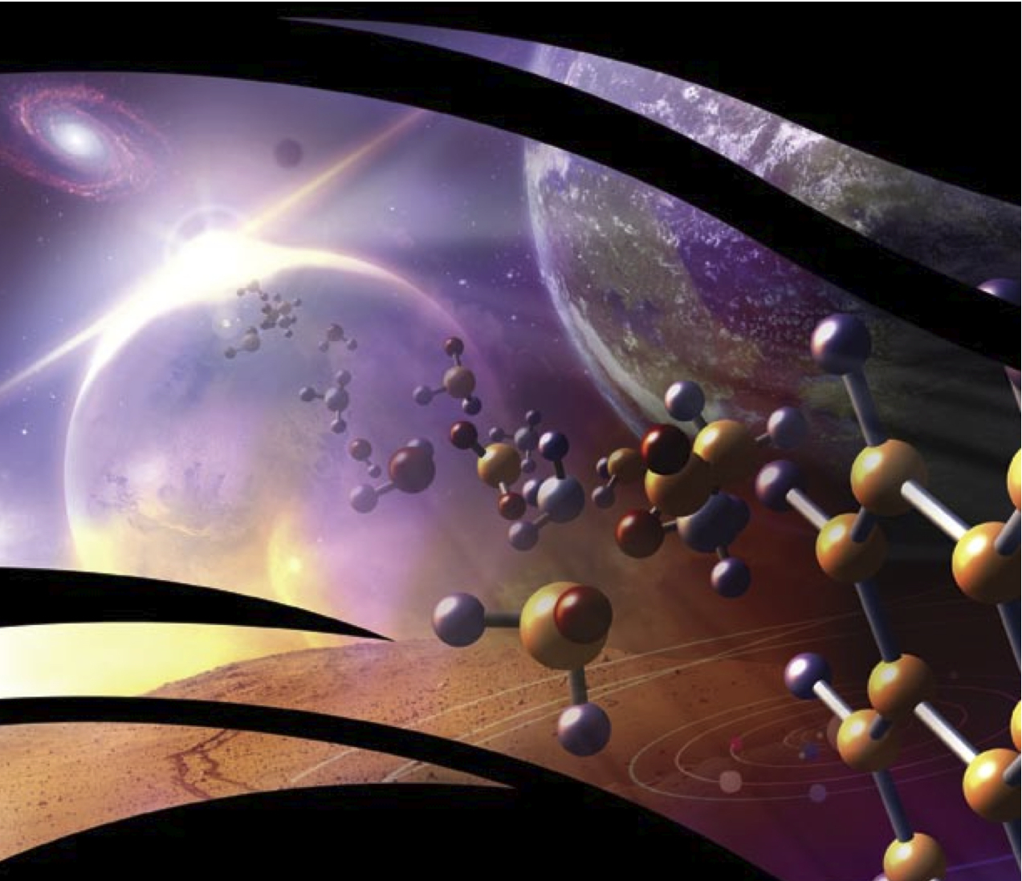

By Team Perseverance
Explorers Guide to Astrobiology

Slide 2
INSTRUCTIONS:
Answer the question by building the word from the scrambled letters above the boxes. Just simply click once and the correct word will appear inside the little boxes below to form the answer.

Slide 3
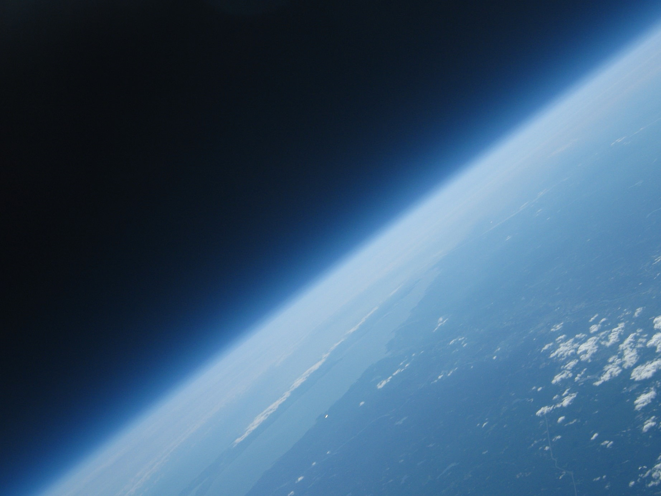
What was the big bang process that made protons and neurons come together to form the planets?
y
u
n
n
e
o
a
d
z
x
g
m
s
s
c
t
h
l
i
s
e
k
w
f
j
p
r
q
v
b
Build the word by clicking on the correct letters above.

Slide 4
What molecules are cellular membranes made up of?
y
u
p
i
p
h
a
c
z
x
g
m
o
i
o
p
h
s
l
s
d
k
w
f
j
e
r
q
v
b
Build the word by clicking on the correct letters above.

Slide 5
What substance (such as an element, isotope, or molecule or phenomenon) provides scientific evidence of past or present life?
y
q
b
t
i
g
d
c
z
x
k
m
n
r
o
u
i
s
a
z
e
k
w
f
j
p
y
q
v
p
Build the word by clicking on the correct letters above.

Slide 6
HOPE YOU ENJOYED THE GAME!
Thank you for playing, the levels in this game are under construction and will still add more in the future. Peace!

